Slide 1
IMAGE PROCESSING
By
Viral 3

Slide 2
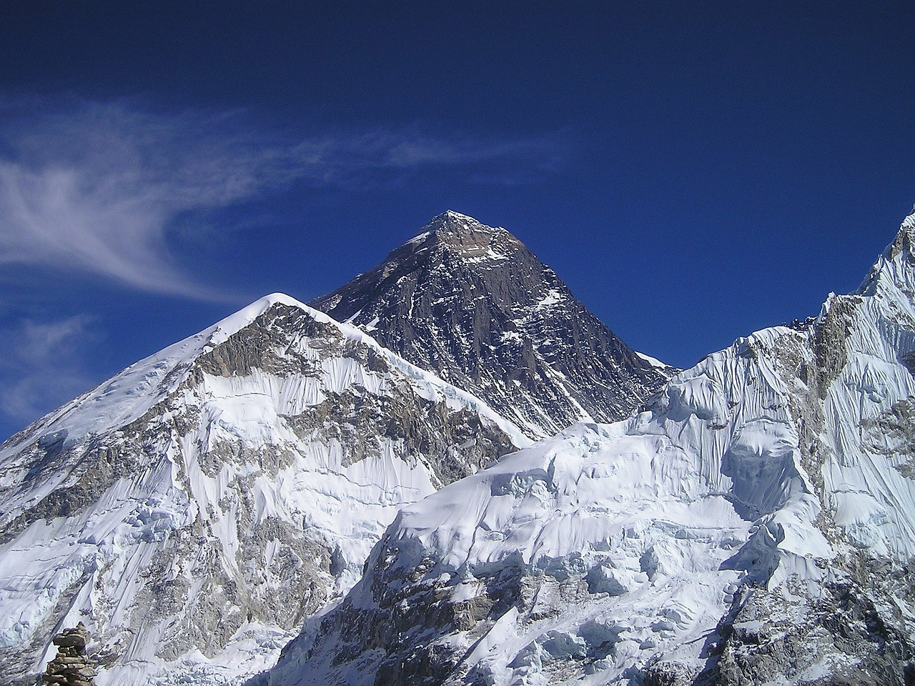
5-Converting from one file format to another
Using PIL, we can read an image in one file format and save it to another
But if the PNG file is in the RGBA mode, we need to convert it into the RGB mode before we save it as JPG, as otherwise it will give an error.
***Providing the correct path to the images on the disk***

